Slide 1
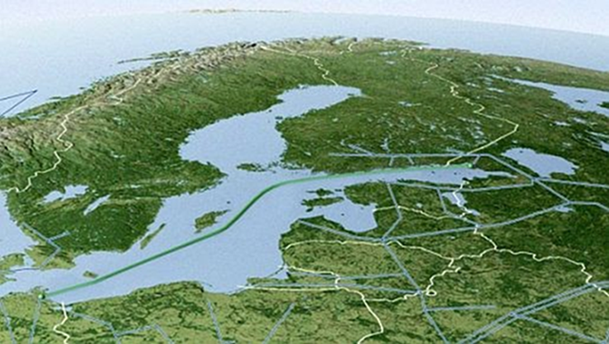

RUSSIA’S NS2 vs EUROPEAN GREEN DEAL:
RUSSIAN GAZOCRACY vs EUROPEAN DEMOCRACY
MYKHAILO GONCHAR
CGS STRATEGY XXI
JUNE 08, 2021

Slide 2
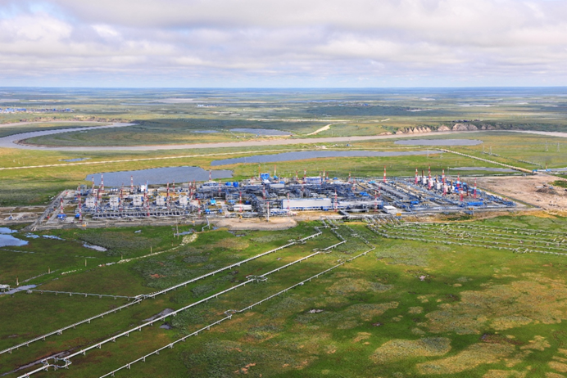
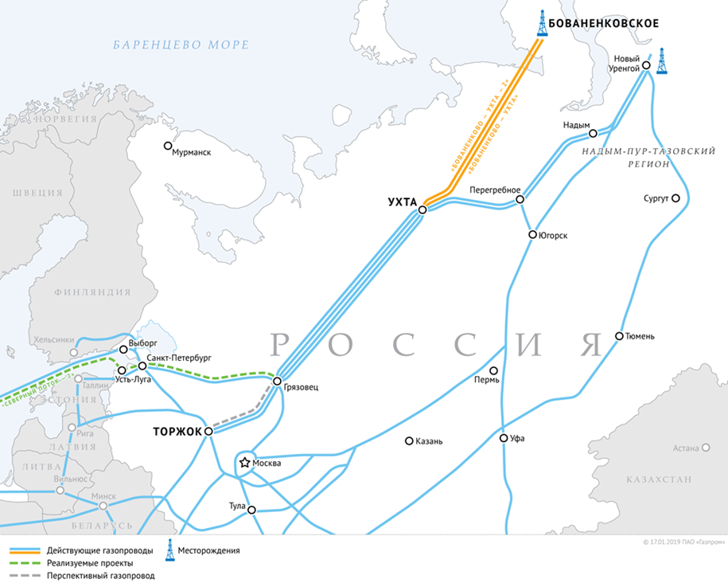
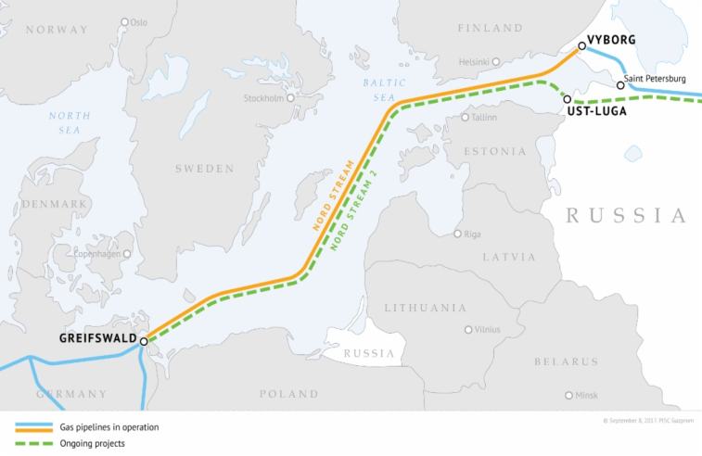
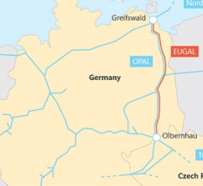
The real route of the Nord Stream 2:
Yamal (Bovanenkovskoye gas field) – Ukhta –
Gryazovets – Ust-Luga – Greifswald – DE/CZ Border
Yamal – Ukhta – Gryazovets – Ust-Luga:
L=3050 km (1200+970+880)
(additional CH4+CO2 emission)
Nord Stream 2: L=1230 km
EUGAL: L=480 km
Total length >4760 km

Slide 3
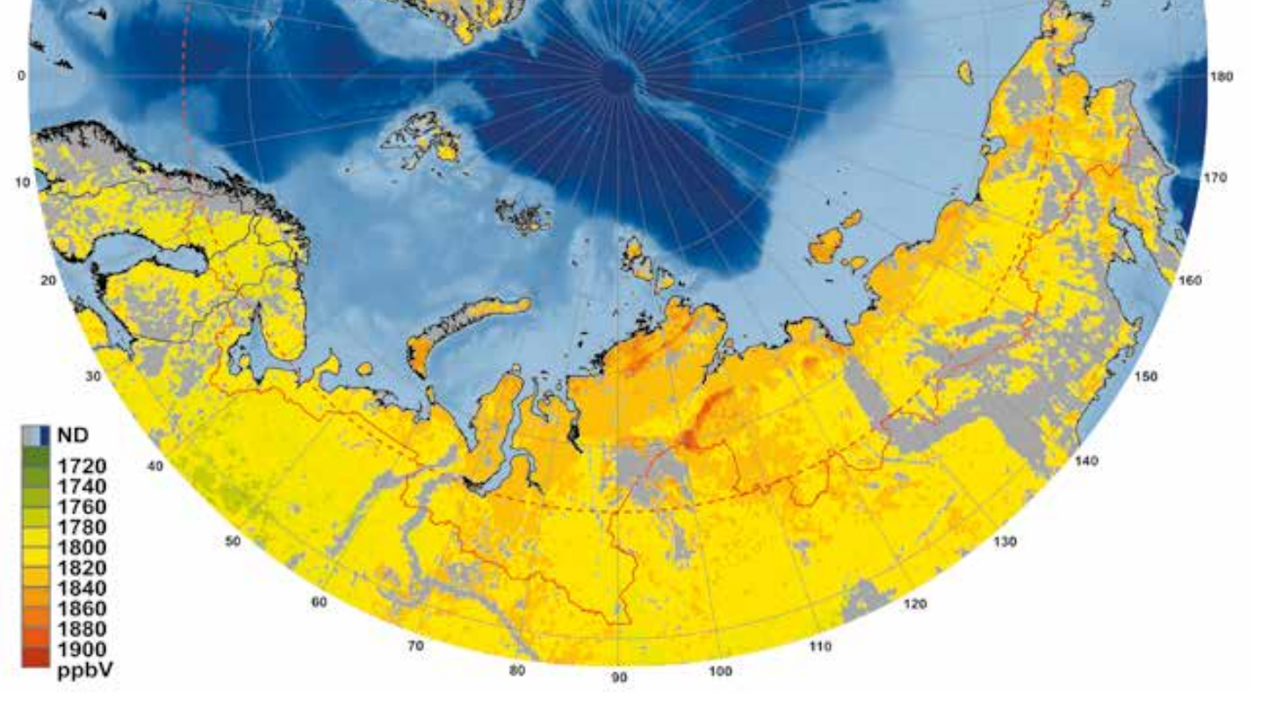
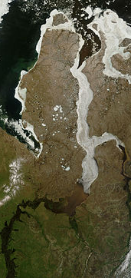
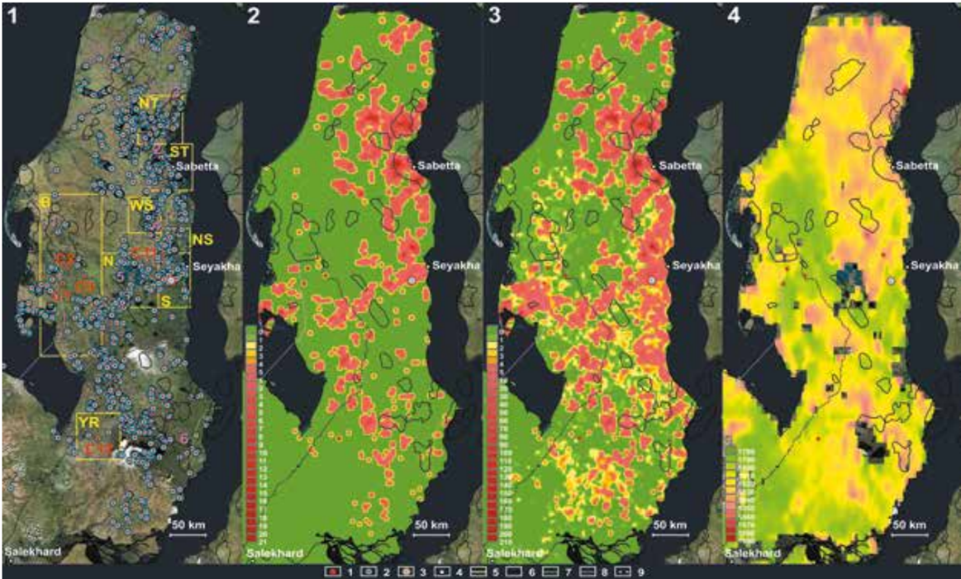
Yamal: CH4 emission
Schemes of gas blowout craters on the Yamal and degassing zones from termokarst lakes with gas emission craters at the bottom (1), density distribution patterns of degassing zones from the lakes with gas emission craters at the bottom (2), scheme of relative risk of gas blowouts (3) and methane concentration distribution (4)
Cartographic diagram of the methane concentration in the Circum-Arctic region
Based on Sentinel-5P TROPOMI spectrometer
Арктика: экология и экономика № 3 (39), 2020

Slide 4
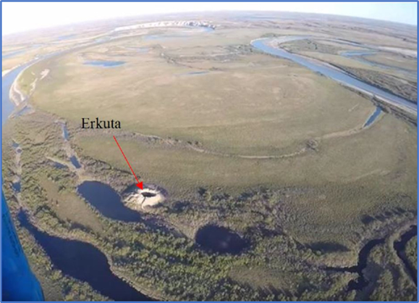
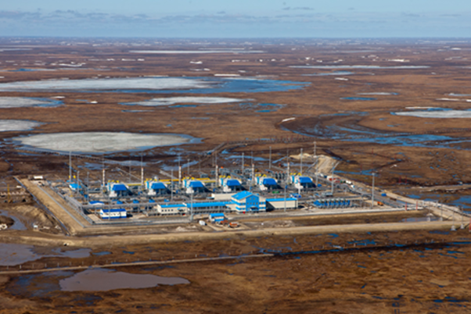
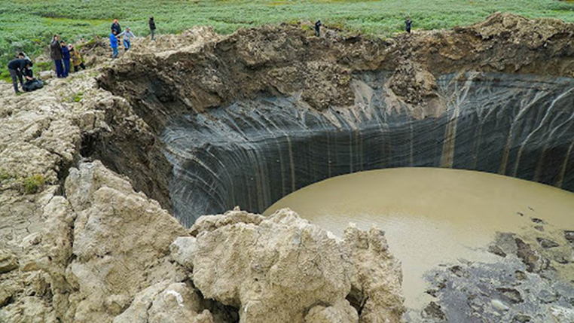
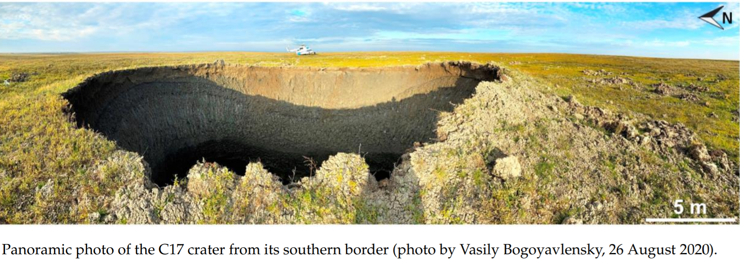
New phenomena generated by global warming:
CH4 emission from cryovolcanoes of Yamal generated by methane-hydrates dissociation means additional risks of emergency for gas infrastructure with CH4 leaks
Evgeny Chuvilin et al. Geosciences, 2020.
Methane crater filling with water after explosion

Slide 5
CONCLUSIONS
NS+NS2 vs GREEN DEAL: RUSSIAN GAZOCRACY + EUROPEAN DEMOCRACY = PERMISSION FOR ADDITIONAL (CH4 + CO2) EMISSION
An American-European joint green initiative to ban the development of fossil resources (coal, oil, gas) in the Arctic regions is needed
An American-European "operation to force Russia to abandon the development of Arctic hydrocarbon deposits“ is needed
The Nord Stream 2 project should be stopped as a matter of priority

Slide 6
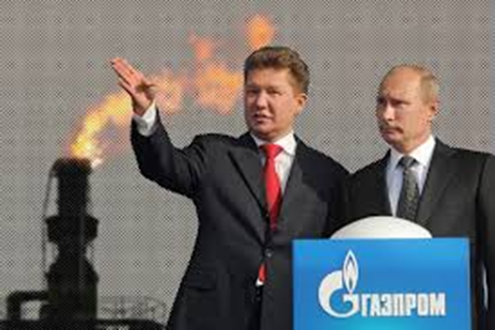
“Swiss family” of Gazprom and Russia’s intelligence services:
Gazprom Schweiz AG, est. 14.05.2003,
Pelikanplatz 15, 8001 Zurich
“Nord Stream AG”, est. 02.12.2005,
Grafenauweg 2, 2304 Zug
“South Stream AG”, est. 18.01.2008,
Industriestrasse 13C, 6304 Zug
“Shtokman Development AG”, est. 21.02.2008
Baarerstrasse 8, 6301 Zug
Gazprom Marketing & Trading Switzerland AG,
est. 07.12.2011, Industriestrasse 13C, 6304 Zug
Nord Stream 2 AG, 15.07.2015
Baarerstrasse 52, 6300 Zug

Slide 7
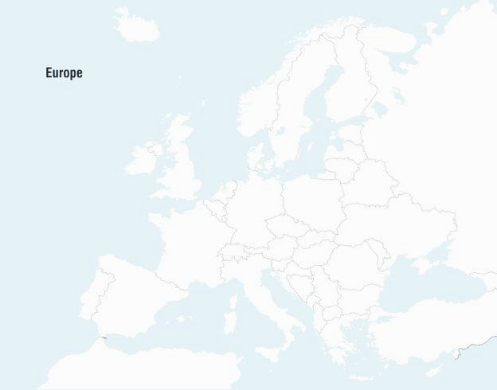
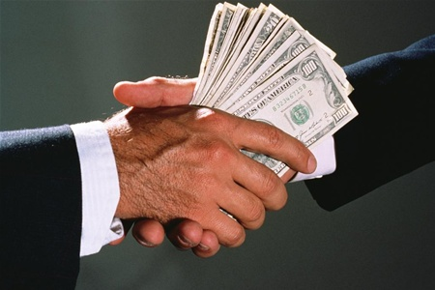
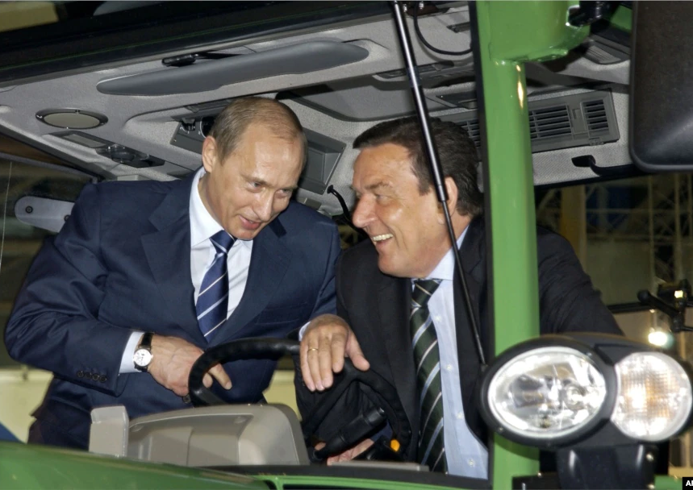
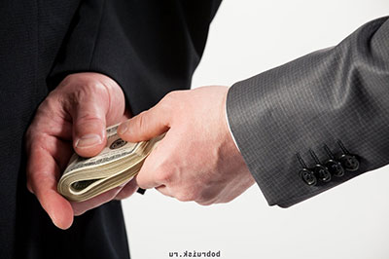

The main outcome of NS is growth of the
Russia’s “elegant corruption” capabilities in Europe.
Swiss “black box” of the transnational corruption
NS AG
NS2 AG
Zug
CASH FLOWS.CH
EU
GAS FLOWS.RU
DE

Slide 8
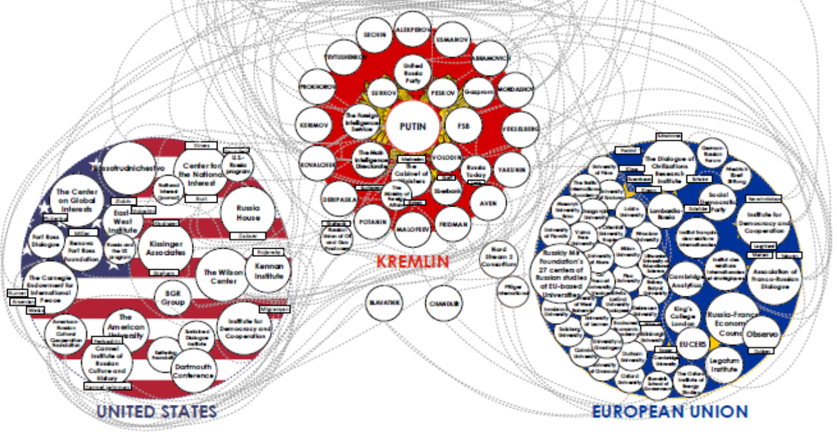
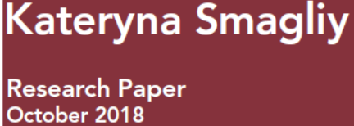
Kremlin influence network in the US and Europe funded by different Russian sources

Slide 9
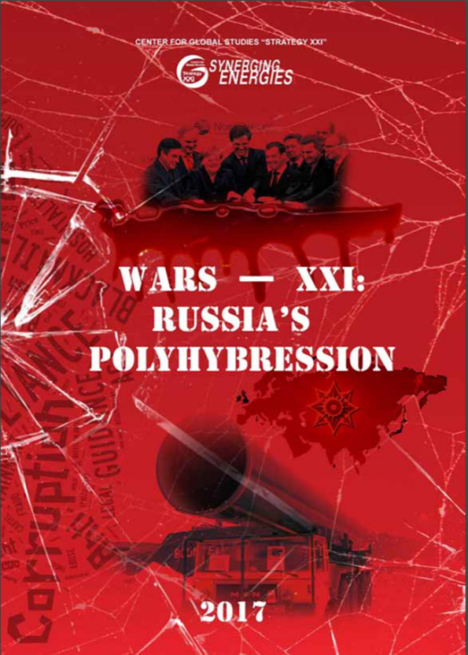



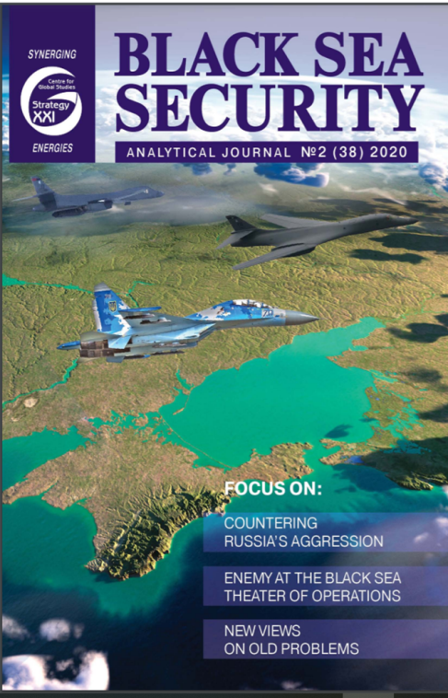
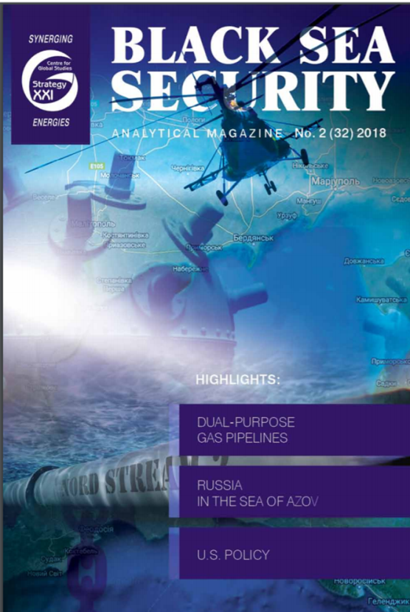
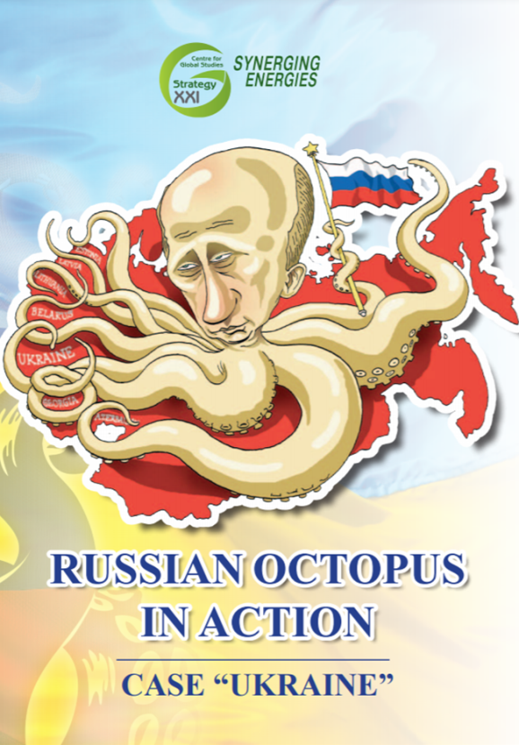
THANK YOU FOR YOUR ATTENTION!
http://geostrategy.org.ua

